Slide 1

Guide to Use JIRA
Developer Roles

Slide 2

Overview
Access to JIRA
Creating new issue on different issue types, and actions required when being assigned on an issue.
Searching issues and issues filter.
Watching an issue
JIRA Dashboard
DAMS Viewer and Logs attaching.

Slide 3
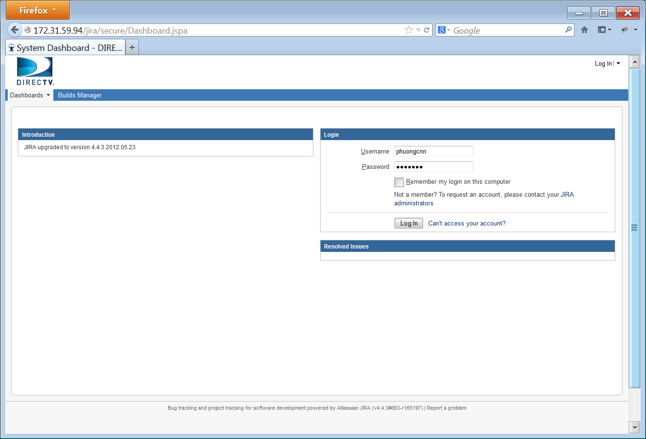

Access to JIRA
Use your web browser to access JIRA at: http://172.31.59.94/jira/
Login with your username and password to continue

Slide 4
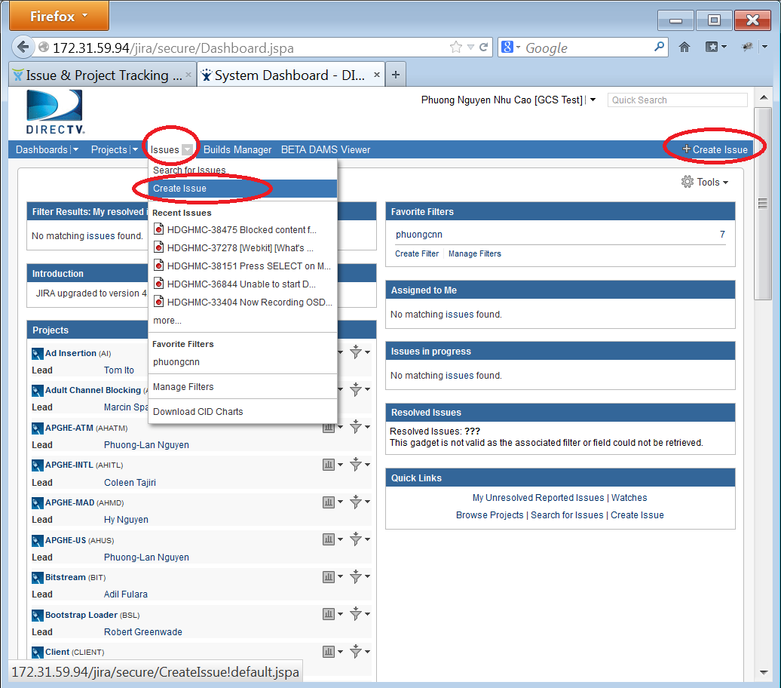
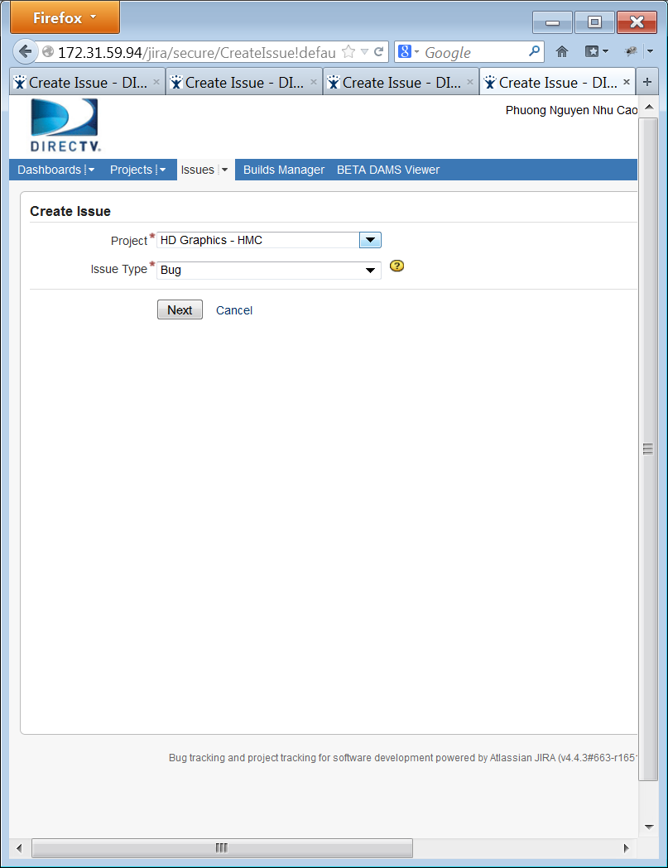

Create new issue
You can quickly create new issue on JIRA by:
Click “Create Issue” link at right corner on navigation bar
Or select “Issue” on menu bar then “Create Issue”
Select the Project and the Issue type then “Next”.

Slide 5


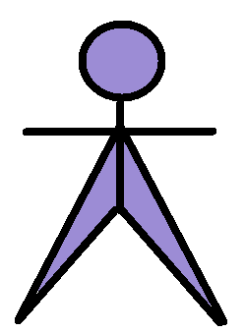

Issue types
Bug
Task
Improvement
Developer
Development Lead
Tester
Test Lead

Slide 6


Bug Workflow
When a defect is found, tester will create new JIRA ticket type bug. The status of the ticket is “Open”.
The ticket will then be assigned to developer to analyze. If you are assigned to that issue and after analyzing the issue, you decide not to fix that issue, you can change the status of the ticket to “Resolved” with specific “Resolution” as described in later.
If you decide to fix it, mark it as “In Progress”, while working on the patch for bug fixing. When the patch is done, set the issue status to “Patch Ready”. It will be reviewed by Dev Lead. If the patch is OK, Lead will set the issue to “Patch Review”.
When the new build is release with the review patch, you can set the status of the issue to “Resolved” as Fixed. The issue will be assigned back to reporter (tester). Now, tester will have to verify that the issue is really fixed. If it is fixed, tester closes it; otherwise he/she reopens it.
Defect found
Open
Tester creates the issue
You
No
Is it issue?
Developer analyzes the issue
yes
In Progress
Patch Ready
Yes
Lead reviews
Ready or
Reject?
Reject
Reopened
Rework ?
Ready
Patch Reviewed
No
No
Resolved
Is issue
fixed?
Yes
Closed

Slide 7
JIRA ticket resolution
When a ticket is set to "Resolved", a "Resolution" must be provided. Below are some common resolutions:
Invalid: the reported issue is actually not a bug.
Incomplete: information in the report is not enough to continue processing, ex: log is corrupted, steps to reproduce are not clear…
Duplicate: there already exists another similar ticket (same root cause), which has not been fixed yet.
Won’t fix: developer decides not to fix the issue.
Cannot Reproduce: the issue reproducibility frequency is low and developer is unable to reproduce it again.
On Hold: the issue takes long time to analyze, or developer decides to fix it later.
In Progress: developer is working on the issue.
Fixed: when a patch for the bug is ready, and passes review by Development Lead, the issue will be resolved as “Fixed”

Slide 8
Issue types
Bug
Task
Improvement
Developer
Development Lead
Tester
Test Lead

Slide 9
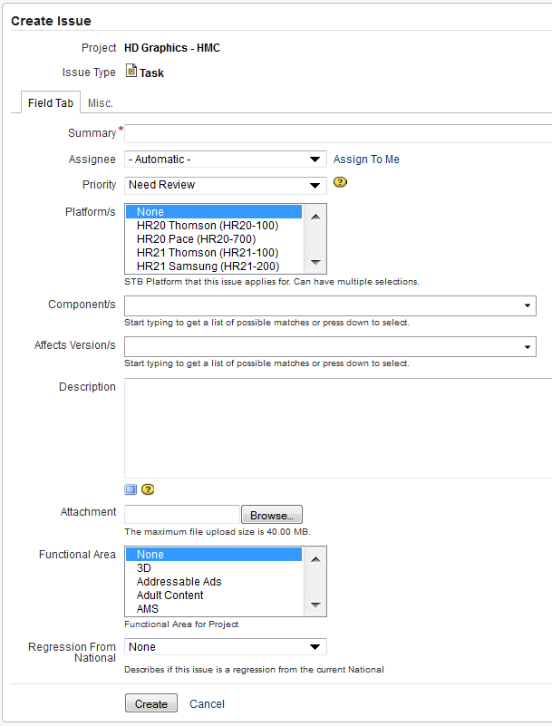
Create new issue - Task
A Task is ideally a Bug. When a developer finds an issue, she/he will open a Task to track works on it until the issue is resolved/closed.
Ticket type Task is also used to request services related to Engineering group, such as requesting authorization, HW or SW request, etc.
Creating a Task is the same as creating a Bug and the meaning of Task’s fields are the same as Bug’s. (Please see the detail of the Bug’s field in Testers part) However, while the Bug requires many mandatory fields, the only mandatory field for a Task is the summary.
A Task has the same workflow as a Bug.
A Task sometimes has many sub-tasks .

Slide 10
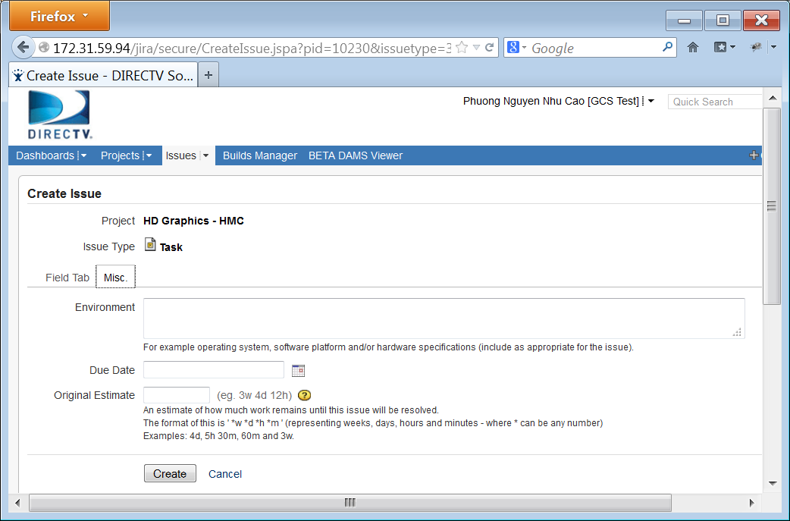
Create new issue – Task (cont.)
When creating a task, “Due Date” and “Original Estimate” fields should also be filled.

Slide 11
Issue types
Bug
Task
Improvement
Developer
Development Lead
Tester
Test Lead

Slide 12
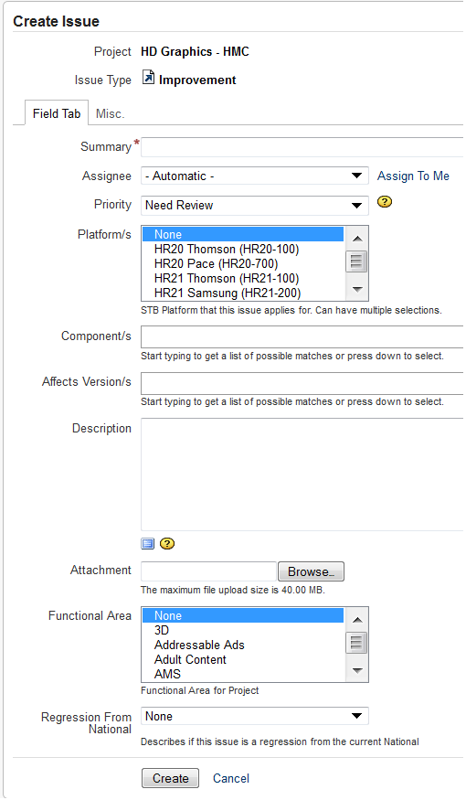
Create New Issue – Improvement
When an existing feature needs to be improved, we create a ticket type Improvement. We use this ticket to track works on the improvement until it is resolved/closed.
Creating an Improvement is the same as creating a Bug and the meaning of Improvement’s fields are the same as Bug’s.
An Improvement has the same workflow as a Bug
An Improvement sometimes has many sub-tasks.

Slide 13
Overview
Access to JIRA
Creating new issue on different issue types, actions required when there is update on issue and assigning issue.
Searching issues and issues filter.
Watching an issue
Dashboard, logs attaching, and DAMS Viewer

Slide 14
Searching Issues
Quick Search
Simple Search
Advanced Search
Issue Filters

Slide 15
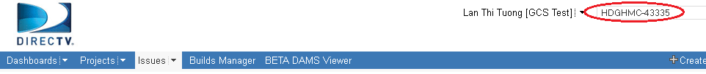
Searching issues – Quick Search
Quick Search supports to go directly to an issue by typing the issue key or run a free-text search.
Jump to an Issue:
The Quick Search box is located at the top right of any JIRA screen. If we type in a correct ID of an issue, we will jump straight to that issue
Ex: type in “HDGHMC-43335” and press Enter, you will be redirected to the JIRA issue with ID = “HDGHMC-43335“

Slide 16
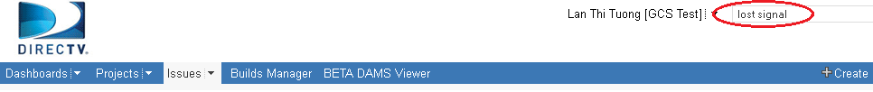
Quick Search – Free text searching
We can search for any word within the issue(s) we are looking for, provided the word is in one of the following fields.
Summary.
Description.
Comments.
Ex: type the string “lost signal” and click Enter, all the issues which contain “lost”, “signal”, “lost signal” are listed on the right hand side of the screen as the search results

Slide 17
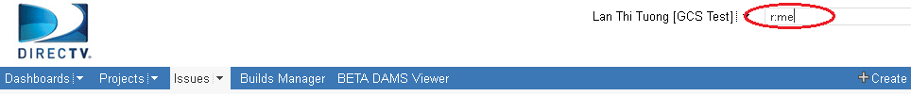
Quick Search – Smart querying
Quick Search also let users perform “smart” searches with minimal typing, called “Smart Querying”. The following table lists some search terms that Quick Search support:
Search Terms | Description | Sample
my | Find issues assigned to me. | my
r: | Find issues reported by you, another user. Using the prefix r: followed by a specific reporter term such as me, username. | r:me – your issues r:lantt – “lantt” issues
<priority> | Find issues with a particular Priority. | Blocker, Low, Critical
<issue type> | Find issues with a particular Issue Type. | Bug, Task, New Feature
Type “r:me” text and press Enter, all the issues created by “me” (current user) will be listed in search results.

Slide 18
Searching issues
Quick Search
Simple Search
Advanced Search
Issue Filters

Slide 19
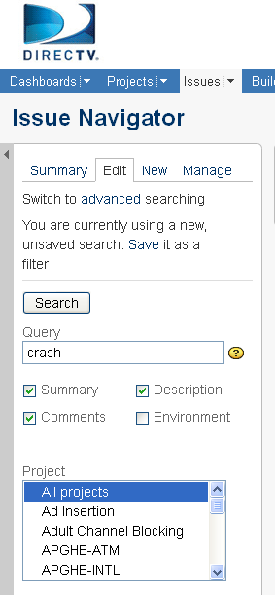
Searching issues – Simple Search
JIRA has a powerful search capability in the simple mode. We can search for issues across projects, versions and components using a range of filter criteria.
How to perform a search:
On the top navigation bar, click the 'Issues' tab => the Issues Filter form is displayed on the left hand side of the screen.
Type your search term into the 'Query' box, and/or select other criteria from the drop-down boxes and check-boxes.
Click on the 'Search' button to perform the search => your search results will be displayed in the right hand side of the screen.

Slide 20
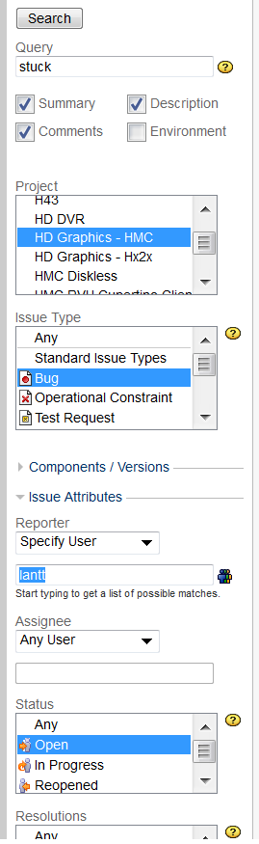
Simple search – example
Simple search example:
To search for all bugs opened by user “lantt”, in “HD Graphics – HMC” project, with “Open” status and contain “stuck” text in their Summary, Comments or Description, the filter should be:
Query string: stuck
Check the boxes: Summary, Comments, Description
Project: HD Graphics – HMC
Issue Type: Bug
Reporter: lantt
Status: Open
Click on the 'Search' button => the search results will be displayed in the right hand side of the screen.

Slide 21
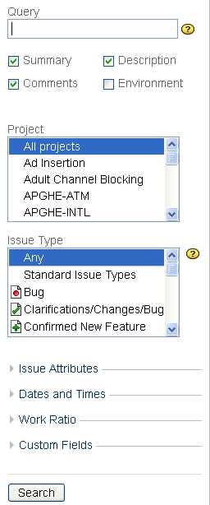
Simple search – criteria groups
In simple search mode, there are many criteria groups to narrow your search:
Simple filter with Query, Project, Issue Type criteria.
Issue Attributes: we can filter for Reporter, Assignee, Status, Resolutions, Priorities, Label.
Date and Times: we can filter for Created After, Created Before, Created, Updated After, Updated Before, Updated, Due After, Due Before, Due Date, Resolved After, Resolved Before, Resolved.
Work Ratio: we can filter for % done of issues (% Limits).
Custom Fields: we can filter for Assignee History, Date of First Response (after), Date of First Response (before), Date of First Response, Executive Visibility, Platform/s, Time in Status.

Slide 22
Searching issues
Quick Search
Simple Search
Advanced Search
Issue Filters

Slide 23
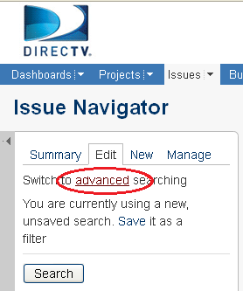
Searching issues – Advanced Search
An advanced search allows you to use structured queries to search for issues.
To perform an Advanced Search:
On the top navigation bar, click the "Issues" tab => This will display the Simple Search panel on the left hand side of the screen.
Click on "advanced“=> This will display the "Query" box.
Type your query using the fields, operators and field values/functions.
Click the "Search" button to run your query => The search results will be displayed below the query.

Slide 24
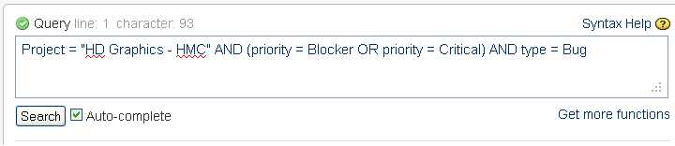
Advanced Search – Example 1
Example 1:
If you want to search for all bugs which belong to “HD Graphics – HMC” project and their priority are “Blocker” or “Critical”, type the following string into the query box:
Project = “HD Graphics – HMC” AND (priority = Blocker OR priority = Critical) AND type = Bug
Click "Search" button, and see the result

Slide 25
Advanced Search – keywords and syntax
Supported keywords, operators, fields, functions (refer to JIRA online help for a complete list)
Keywords: OR, AND, NOT, EMPTY, NULL, ORDER BY
Operators: =, !=, >, <, >=, <=, IN, NOT IN, ~ (contain), !~,…
Fields: assignee, created, category, project, priority, reporter, status, text, type, updated, description, watcher, resolution,…
Functions: membersOf(), currentUser(), currentLogin(), lastLogin(), startOfDay(), endOfDay(), startOfWeek(), endOfWeek(), startOfMonth(), endOfMonth(), releasedVersions(), unreleasedVersions(), latestReleasedVersion(), earliestUnreleasedVersion()…
JIRA supports Auto-complete function: As you type your query, JIRA will recognize the context and offer a list of "auto-complete" suggestions for you.
We can save the query for future use. We can also share the query with Group, Project or Everyone to utilize it.

Slide 26
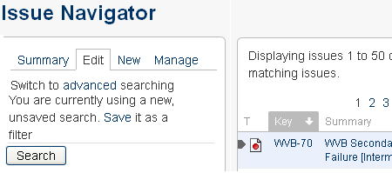
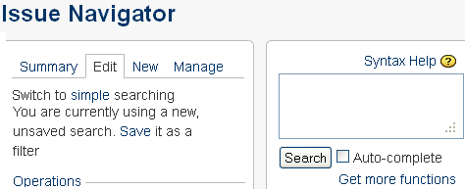
Switching between Advanced and Simple Search
On the top navigation bar, click the "Issues" tab. This will display the Search panel, this is also Simple Search page. On this, click "advanced". This will display the "Query" box of Advanced Search.
The same, on Advanced Search page, click on “simple” to switch back to Simple Search.
In general, a query created using 'Simple Search' will be able to be translated to 'Advanced Search‘, and back again. However, a query created using 'Advanced Search' may not be able to be translated to 'Simple Search‘, particular if the query contains one of below operator: OR, NOT, EMPTY, !=, IS, IS NOT, >, >=, <, <=, or the query specifies a field and value that is related to a project.

Slide 27
Searching issues
Quick Search
Simple Search
Advanced Search
Issue Filters

Slide 28

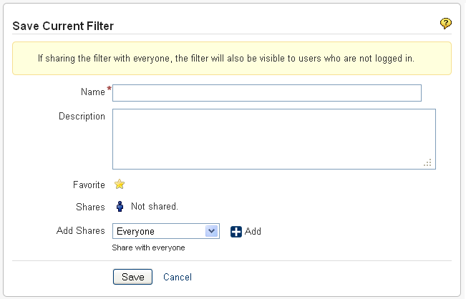
Issue Filters - Saving Searches
A saved search is called an 'issue filter'.
After doing your search, click the ‘Save it as a filter’ link in the left-hand column of the Issue Navigator.
Provide a name, description, favorite, share or not, then save your filter.

Slide 29
Issue Filters – Manage Filter
On the top navigation bar, click the 'Issues' dropdown and select 'Manage Filters' from the list.
The 'Manage Filters' page will display. From this page, you can perform the functions listed below:
Create a new search to be saved as a filter.
Add a filter as a favorite.
Share a filter that you have created with other users.
Search for filters that has been created by you or shared with you by other users.
Update an existing filter's details or edit a filter's search criteria for a filter that you have created.

Slide 30
Overview
Access to JIRA
Create a new issue
Searching for issues and issue filter.
Watching an issue
JIRA Dashboard
DAMS Viewer and logs attaching

Slide 31
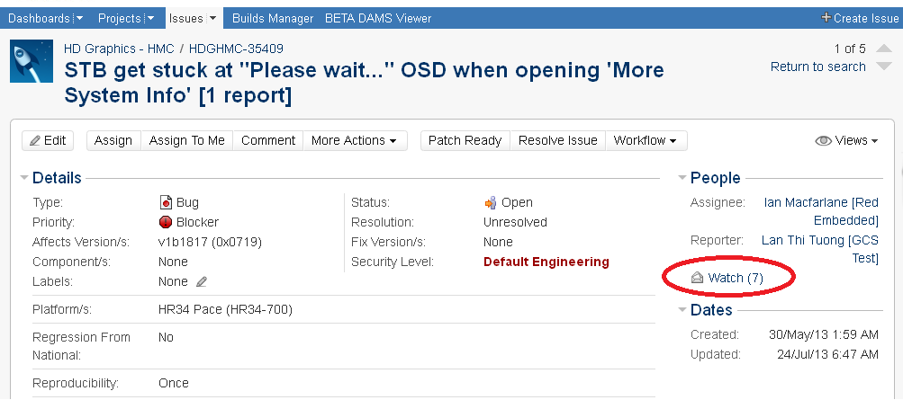
Watching Issues
Watching Issues
JIRA allows users to watch for a particular issue, all watchers will be notified by email for any updates or comments on that issue.
Click on the “Watch” icon to become a watcher of the issue.
Click on the “Watch” icon again to stop watching the issue.

Slide 32
Overview
Access to JIRA.
Creating new issue on different issue types, actions required when there is update on issue and assigning issue.
Searching issues and issues filter.
Watching an issue.
Dashboard, DAMS Viewer, and logs attaching.

Slide 33
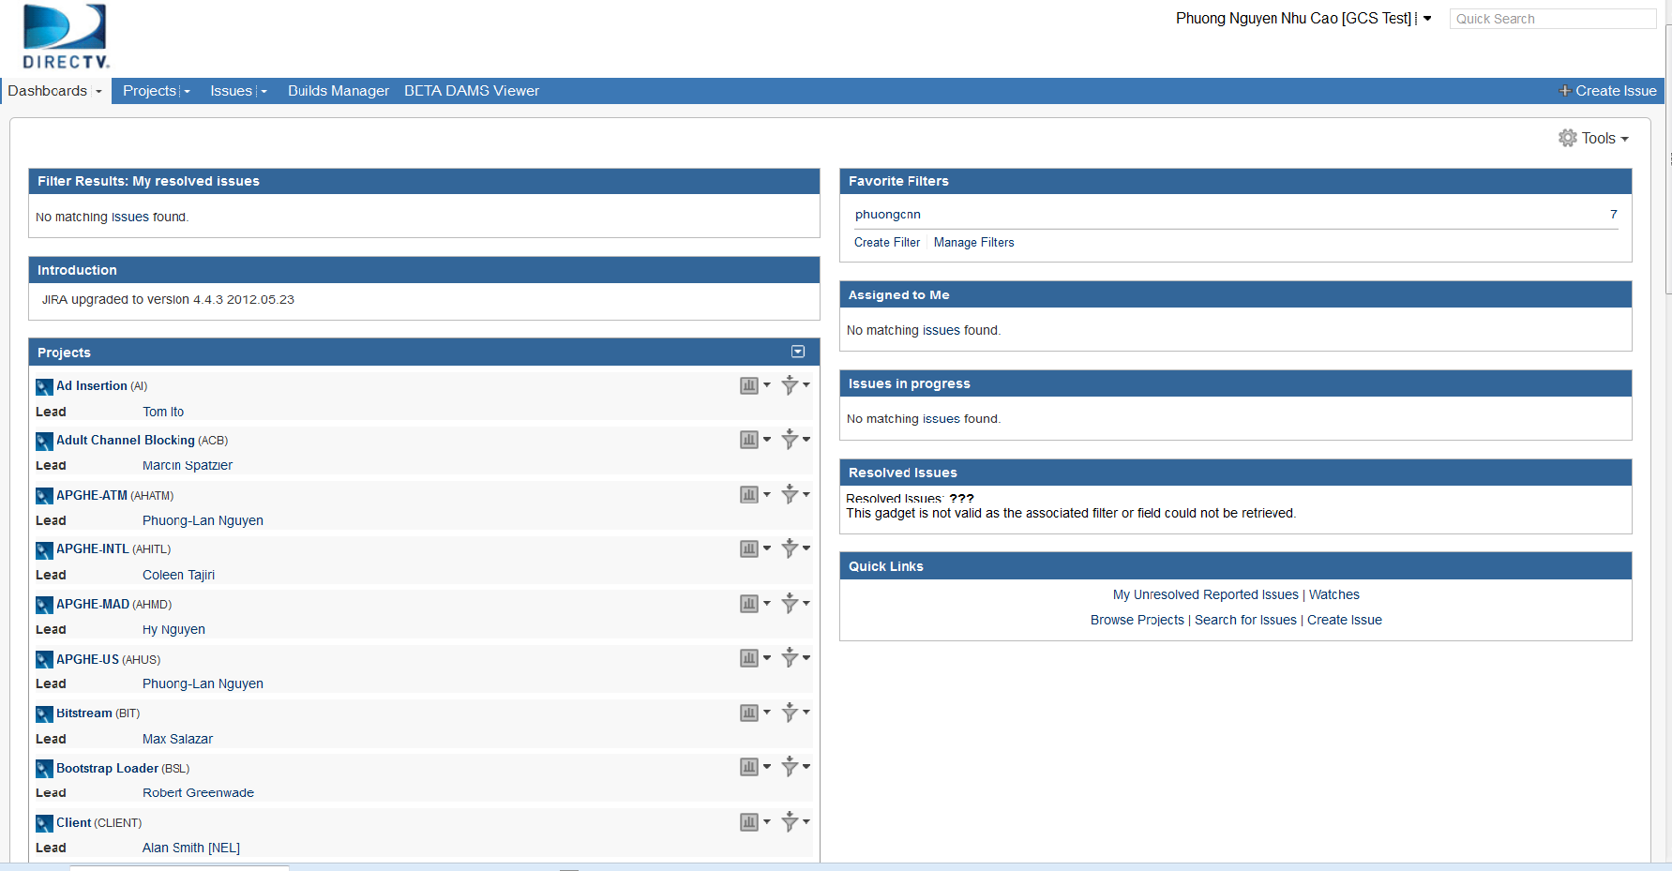
Dashboard
Dashboard
JIRA Dashboards is the first screen you see after you log into JIRA.
It can be configured to display many different types of information, depending on each user’s interest.
If you have not created any dashboard, you will see the system dashboard as below.
The information boxes on the dashboard are called Gadgets.
Notes:
The JIRA Dashboards is the first screen you see when you log in to JIRA.
It can be configured to display many different types of information, depending on your areas of interest.
The information boxes on the dashboard are called Gadgets

Slide 34
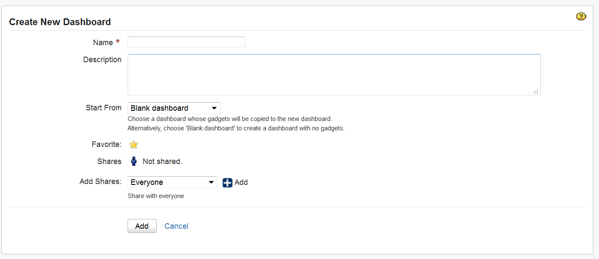
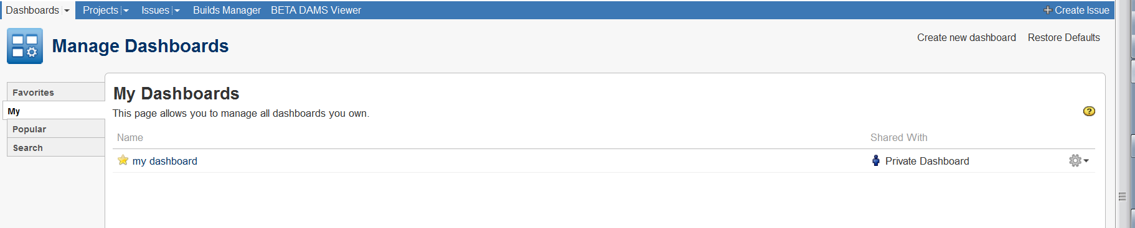
Dashboard – Create new dashboard
Create new dashboard from blank.
Notes:
Here I click on “Create New Dashboard”
I name the Dashboard “my first dashboard”->Start From Blank dashboard ->Select Favorite->Shares : Not shared so only I can see and use this dashboard.
Then click Add.
Now select the “blank dashboard” I just created.

Slide 35
Dashboard – Customize Dashboard
You can easily customize your dashboard by
Add more gadgets
Drag and drop to reposition the gadgets
Change the look of individual gadgets
Choosing a different layout
You can also
Create more pages for your dashboard
Share your pages with other people
Choose your favorites pages

Slide 36
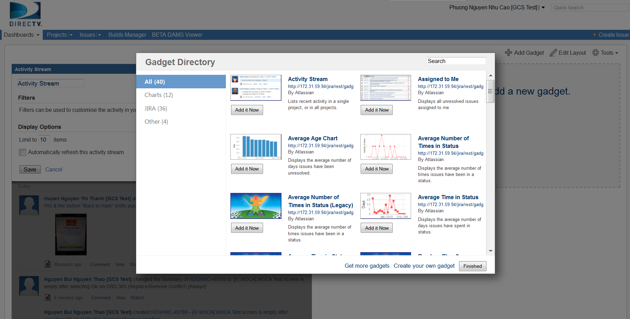
Dashboard customization – add gadgets
Add gadgets to dashboard.
Notes:
Click on “add new gadget”
Then select the “Gadget You can easily customize your dashboard by choosing a different layout, adding more gadgets, dragging the gadgets into different positions, and changing the look of individual gadgets.

Slide 37
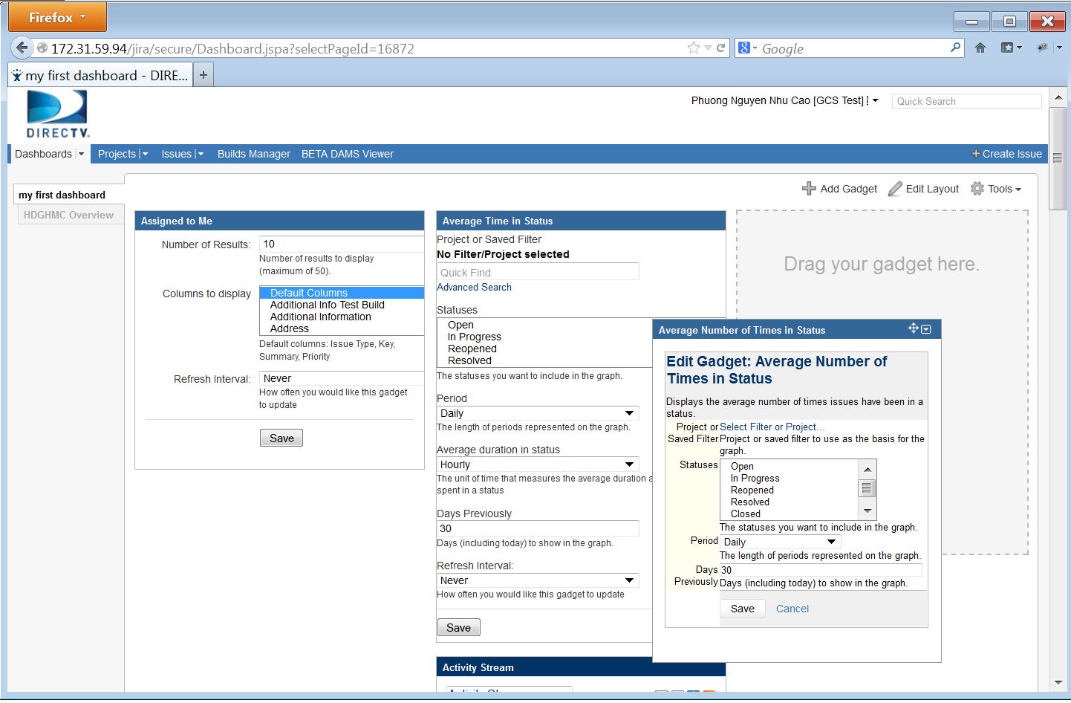
Dashboard customization – drag and drop
Click on the header of each gadget
Drag it to the desired location to reposition

Slide 38
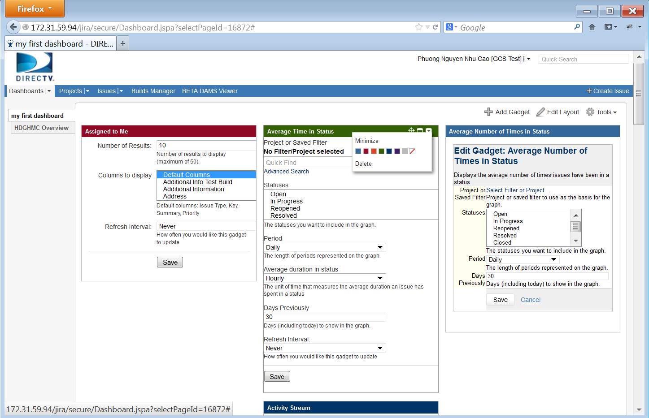
Dashboard customization – change gadget style
You can change the individual look of a gadget by clicking the dropdown icon from gadget header, then choose desired color

Slide 39
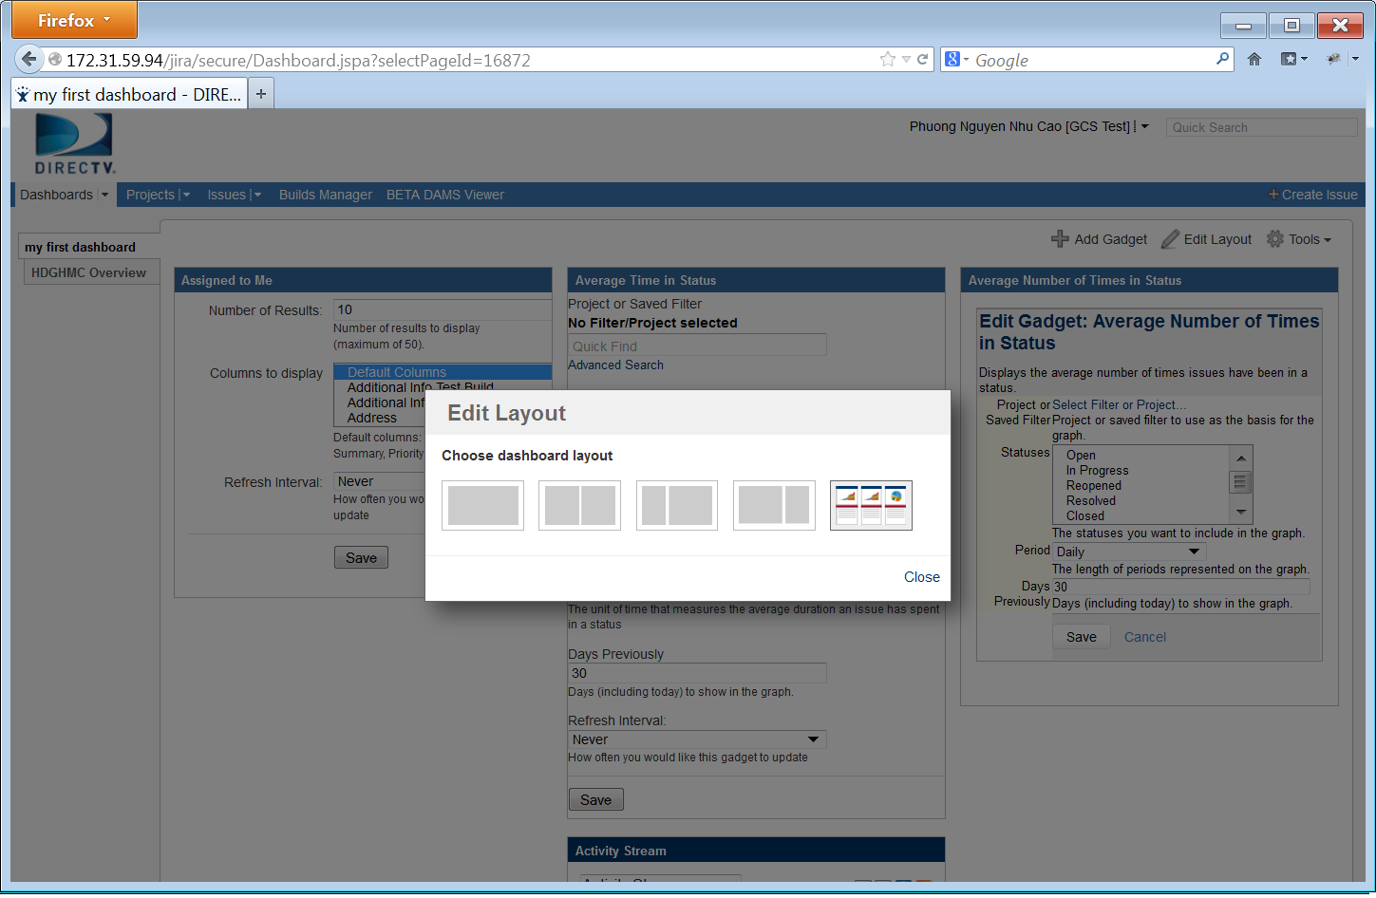
Dashboard customization - layout
You can easily customize your dashboard by choosing a different layout.
Click "Edit Layout", then choose the layout you want.

Slide 40
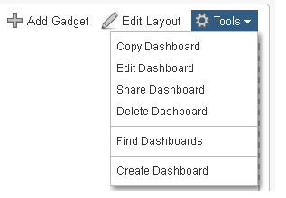
Dashboard – Customize Dashboard
Copy Dashboard
Edit Dashboard
Share Dashboard
Delete Dashboard
Find Dashboard
Create Dashboard

Slide 41
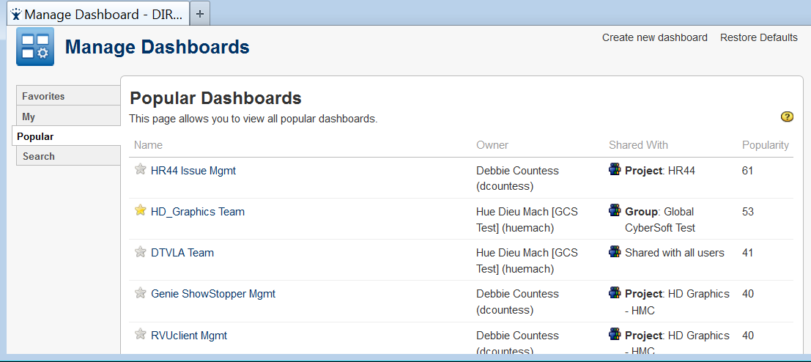
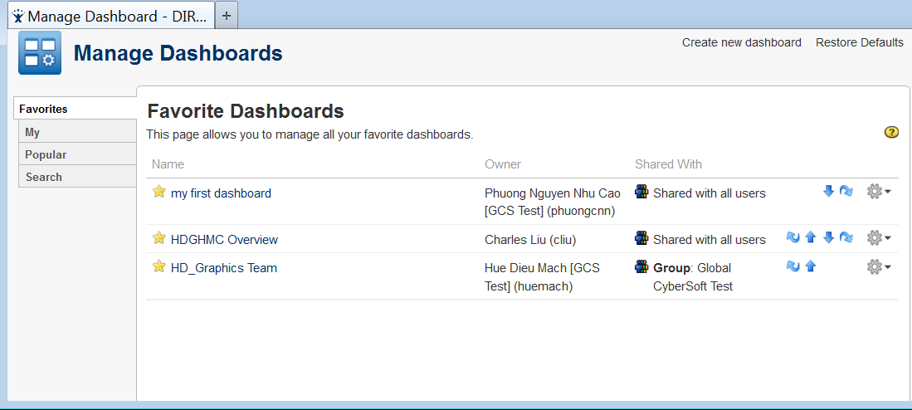
Dashboard – Customize Dashboard (cont.)
You can add pages to your favorite.

Slide 42
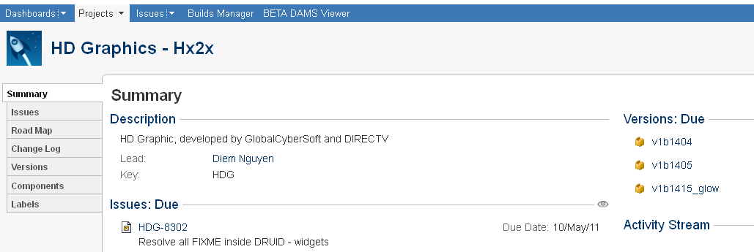
Browsing a Project
The project browser screen: provides a general overview of your project, with a variety of easily accessible reports for your project's issues, builds and source code reviews, from which you can 'dig down' into further detail.

Slide 43
Browsing a Project – Project Information
Choosing a project, then you can browse the following:
Summary: Shows recent activity in your project
Issues: Shows a summary of all issues in a project grouped by Status
Road Map: Shows unresolved issues for upcoming versions of a project.
Change Log: Shows resolved issues for previous versions of a project.
Versions: Shows a summary of recent versions for a given project.
Components: Shows a summary of all components for a given project.
Labels: shows all the most popular labels and its associated content.

Slide 44
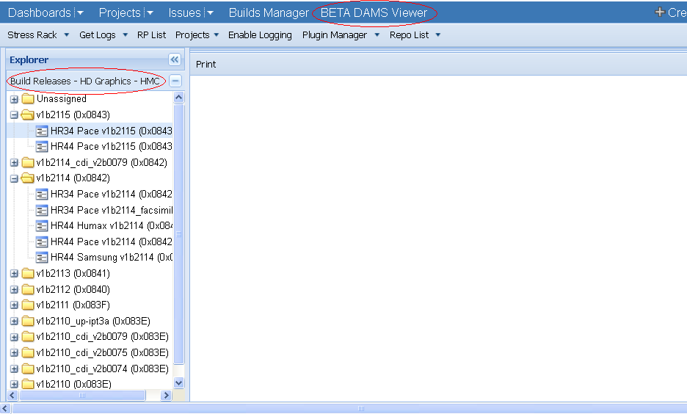
DAMS Viewer
DAMS Viewer provides users some useful facilities to learn about projects such as their releases and fixes, comparing the fixes between releases, attaching logs to an issue, RP List, Plug-in Manager,…
To open the DAMS Viewer: On the top navigation bar, click the ‘BETA DAMS Viewer' tab => the DAMS Viewer is opened with the current project’s releases listed on the left panel.

Slide 45
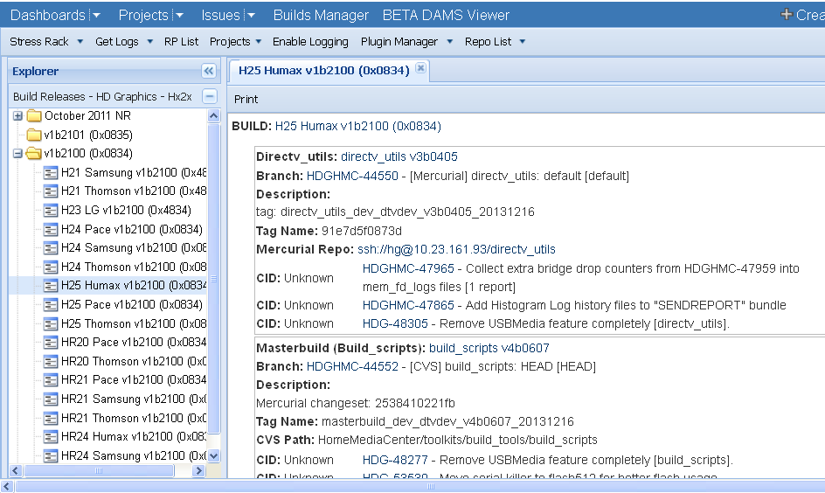
DAMS Viewer – Detail of a release
To change project: click on the “Projects” drop down list arrow, then select your desired project => The releases list is updated accordingly to the new project.
To view details information of a release, double click on the release => the fixes in detail of the release are displayed on the right panel.

Slide 46
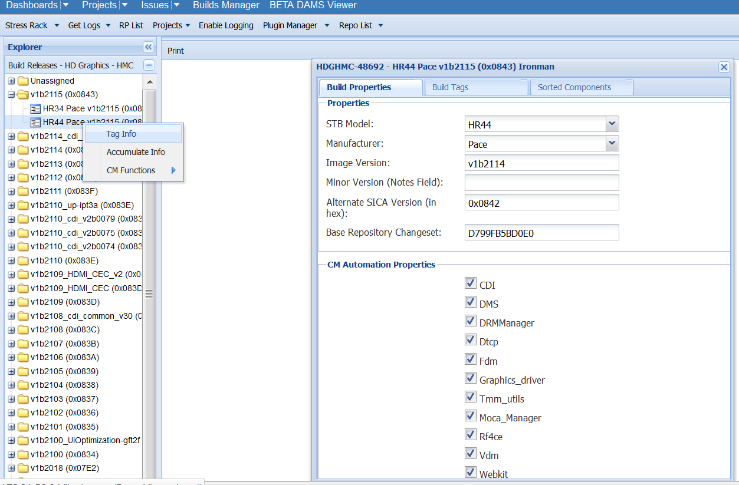
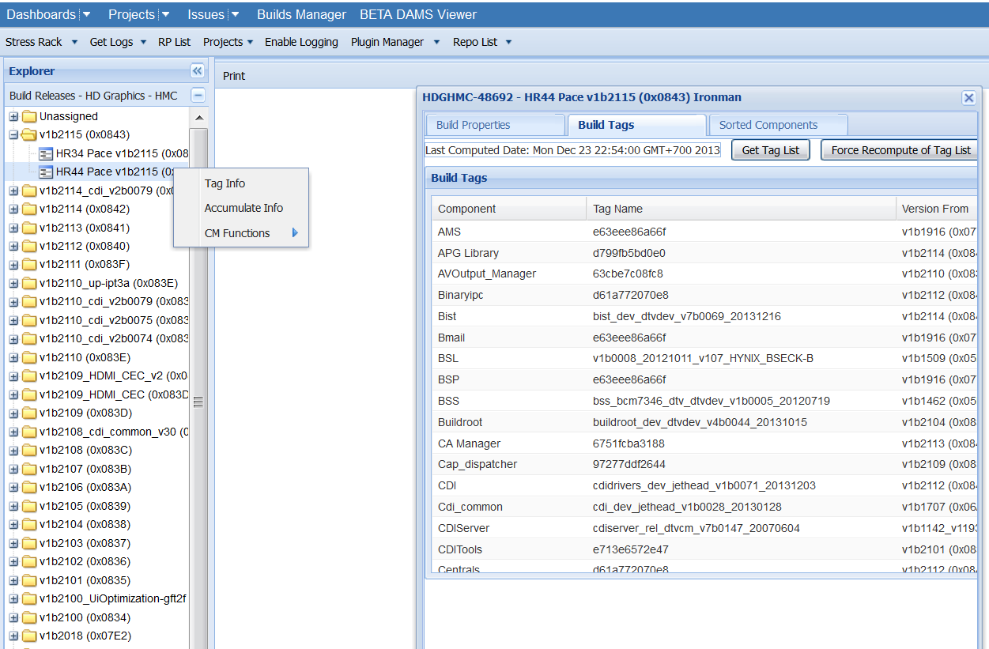
DAMS Viewer – View tags of a Release
To manage tags of a Build Release ticket, right click on a build, select Tag info, select Build Tags tab, and click on “Get Tag List” => List of all tags belong to the Build is displayed.
If the tags of the release have been updated, select “Force Recompute of Tag List”.

Slide 47
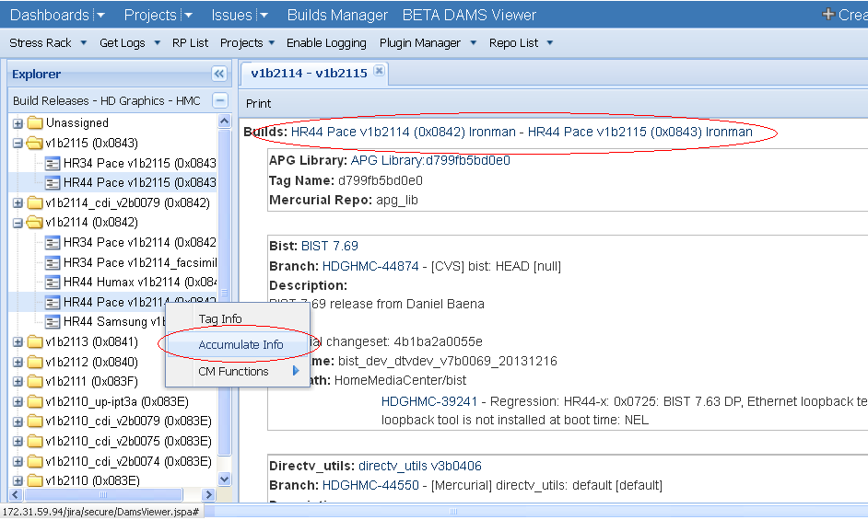
DAMS Viewer – Fixes between two releases
To compare the fixes between two releases: select 2 releases then right-click on one of them and then select “Accumulate Info” => the comparison results are displayed on the right hand side of the screen.

Slide 48
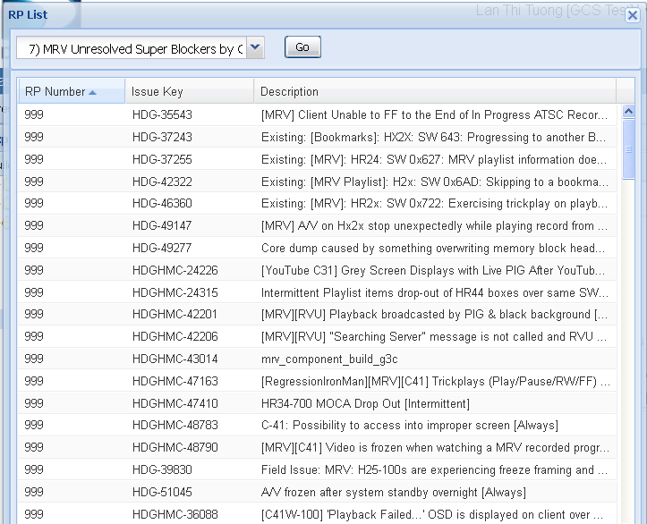
DAMS Viewer – RP List
JIRA provides a list of shared filters or queries for users to utilize them.
On the navigation bar, click the “RP List" => This will display the RP List screen with lots of shared filters/ queries.
Select a filter you want to execute then click on “Go“ button => This will display the filter results with the issues’ keys and descriptions.

Slide 49
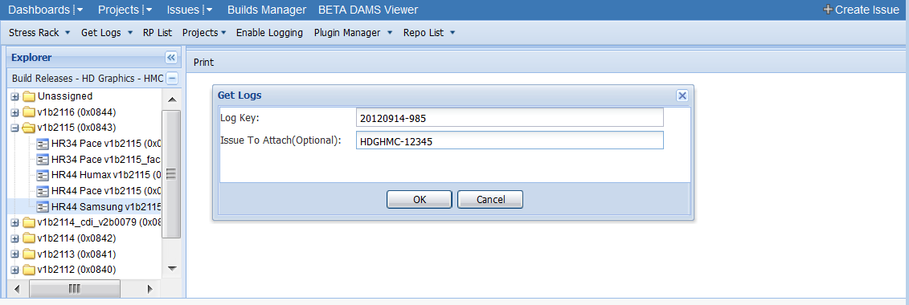
DAMS Viewer – Get Logs
We can attach logs from STB to an issue by using “Get Logs” facility.
To attach logs: click on “Get Logs”, then enter the “Log Key” that was created when getting logs from STB, and enter the “Issue To Attach” (the issue ID), then click on “OK” button => the logs will be attached to the issue in a while.

Slide 50
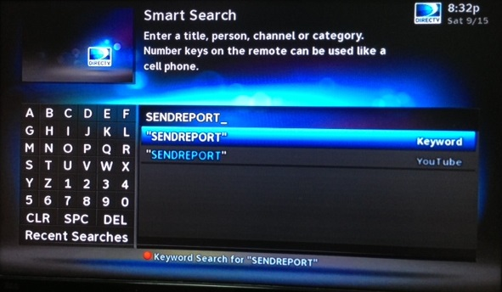
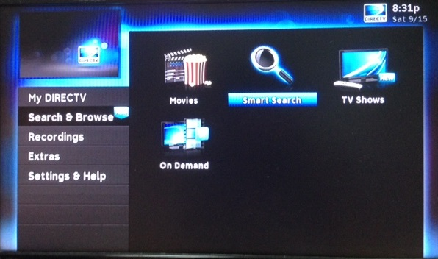
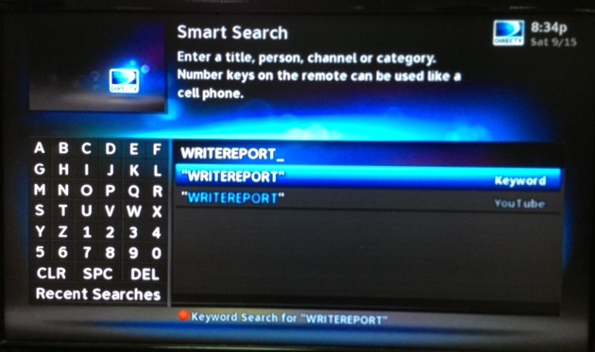
Attaching logs
When creating an issue, usually a Bug/Improvement, reporter must provide the log from STB. There are several ways to provide the logs:
Getter utility captures the logs and stores it on ftp server, then emails the link to logs to the tester.
Users with internet connection can use SENDREPORT search and users without internet connection can use WRITEREPORT to capture the STB logs on USB key.
The above keywords can be searched using Menu/Search & Browse/Smart Search

Slide 51
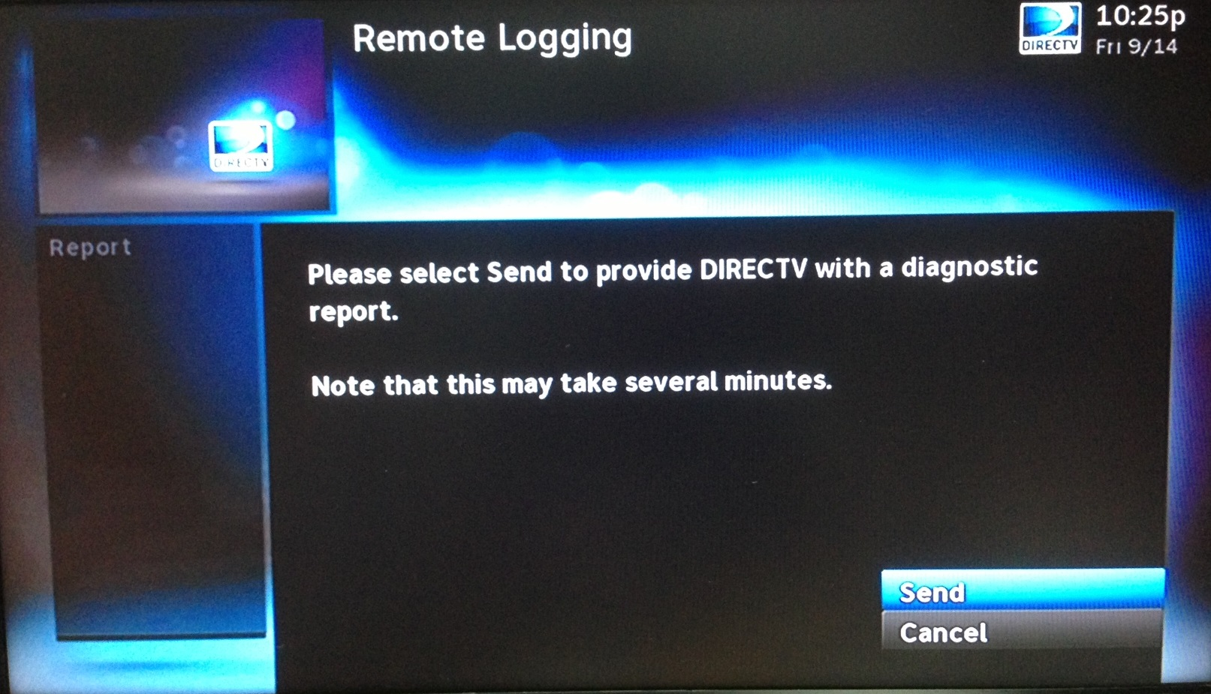
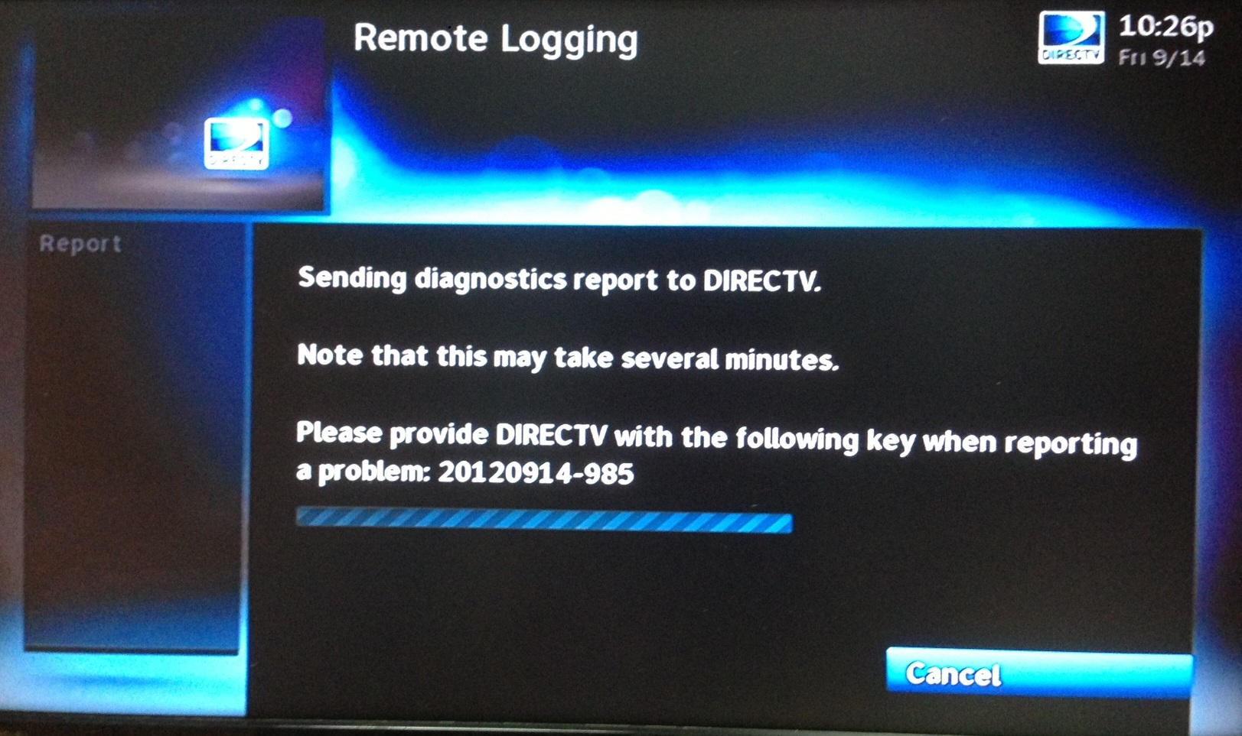
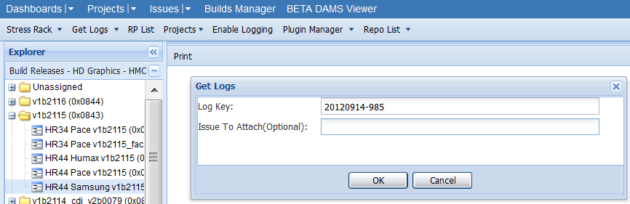
Attaching logs with SENDREPORT
The logs stored in STB will be sent to DIRECTV server when performing "SENDREPORT" in keyword search. A “Log key” will also be generated.
To attach the log to JIRA, you can use “Get Logs” in JIRA DAMS Viewer.

Slide 52
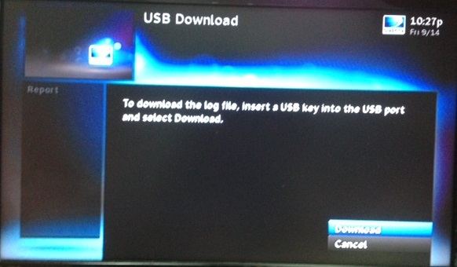
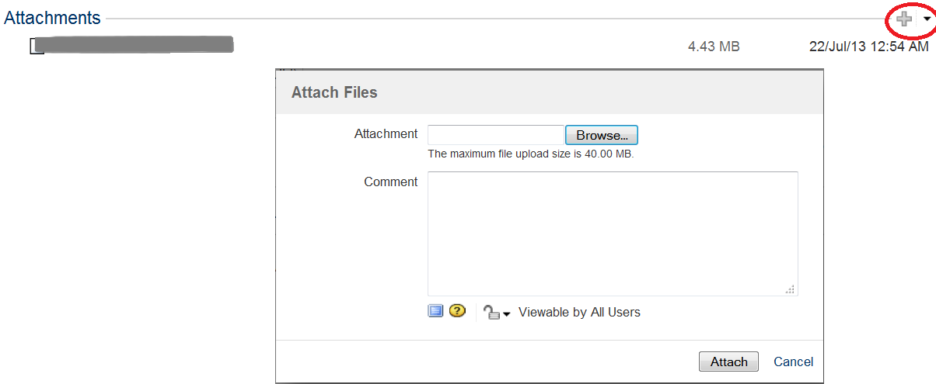
Attaching logs with WRITEREPORT
The SENDREPORT in keyword search requires internet connection from STB to DIRECTV server. What if we get problems with the connection?
We can download the log from STB to USB key by performing WRITEREPORT in keyword search, then attach the log file to JIRA.

Slide 53
Thank you

